Slide 1
Course #4:
Recurrent Neural Networks

Slide 2
Roadmap
Recap from course #3
Auto-encoders
Recurrents Neural Networks

Slide 3
Lecture. #3
Things to know (AE)
Auto-encoder
Latent variable
UNet
ResNet
Notes:
feedforward network = feedforward neural network = multilayer perceptron

Slide 4
Recurrent Neural Networks
Notes:
Pas eu le temps d’abord l’optimisation
Il faut le faire en deuxième séance

Slide 5
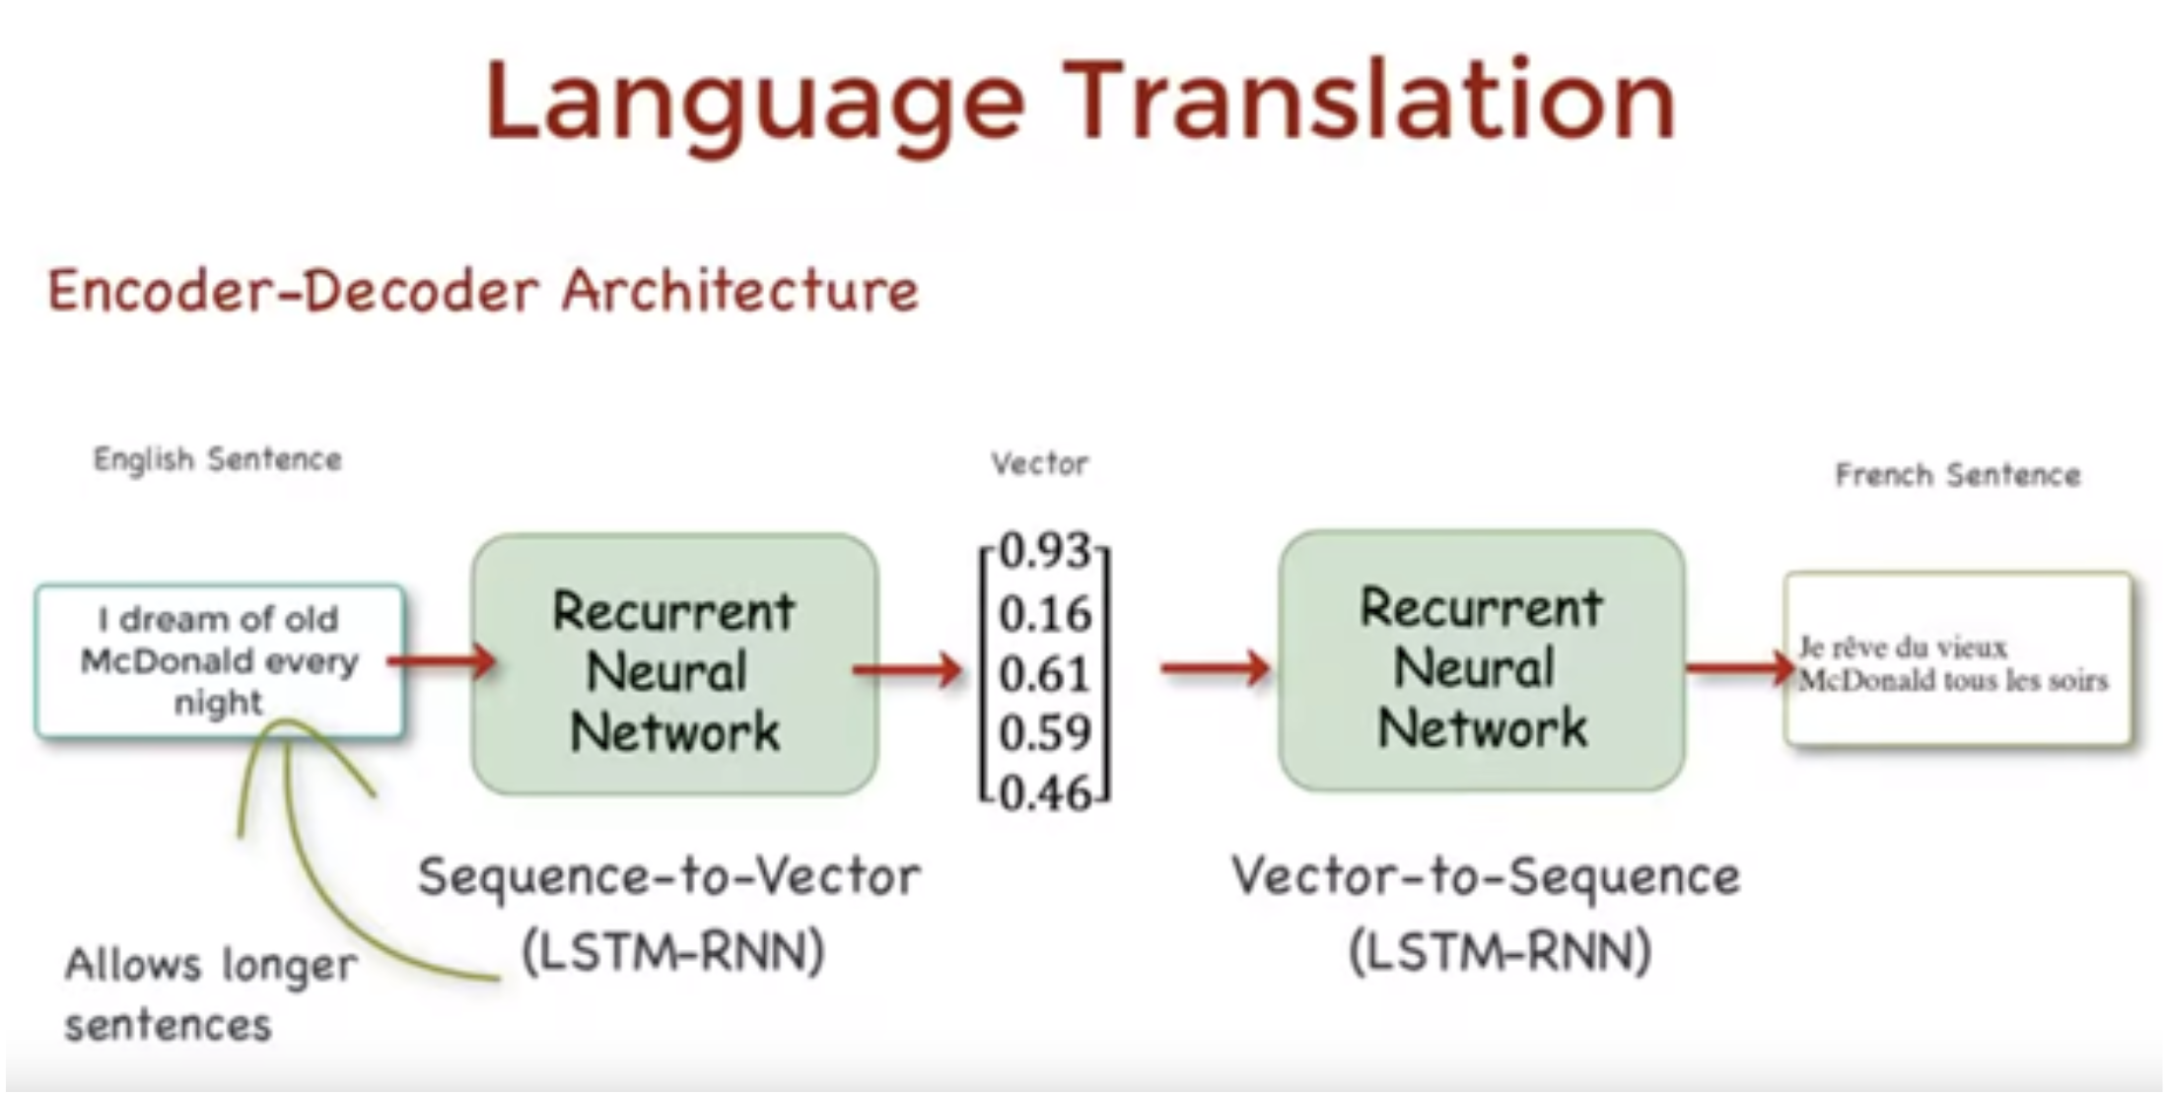
Application to text data
https://towardsdatascience.com/understanding-neural-machine-translation-encoder-decoder-architecture-80f205643ba4
Notes:
Pas eu le temps d’abord l’optimisation
Il faut le faire en deuxième séance

Slide 6
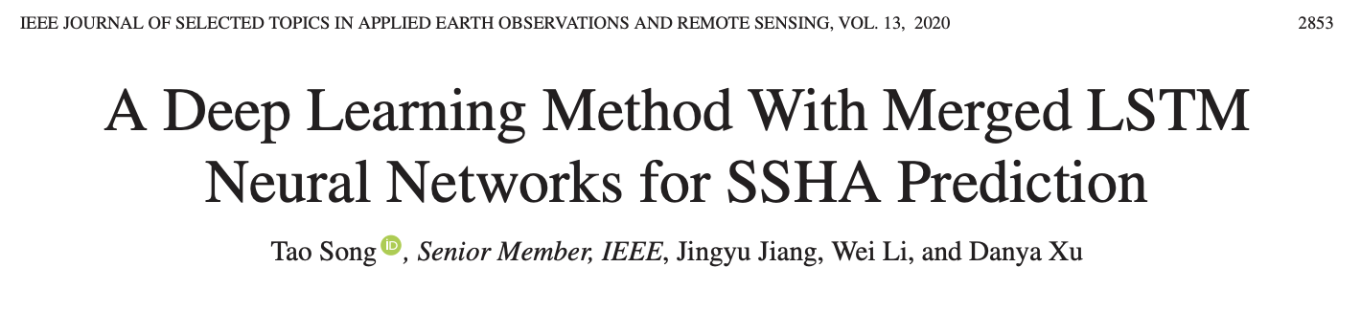
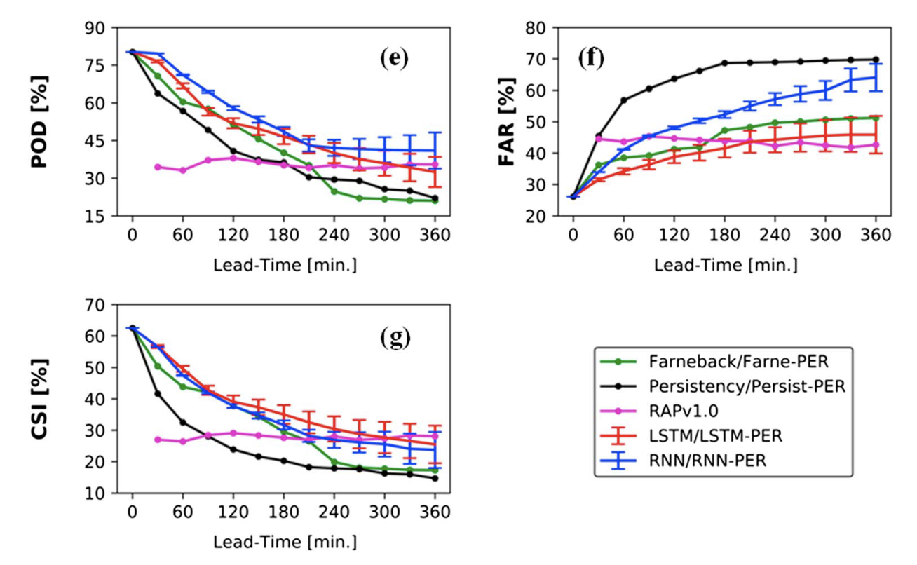
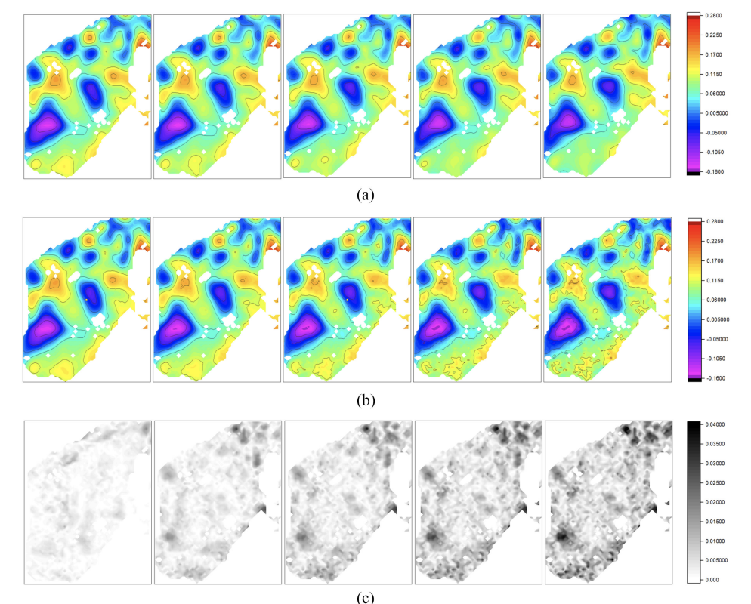
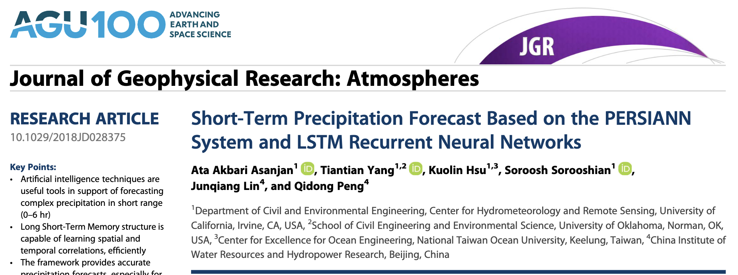
Applications to geoscience
Notes:
Pas eu le temps d’abord l’optimisation
Il faut le faire en deuxième séance

Slide 7
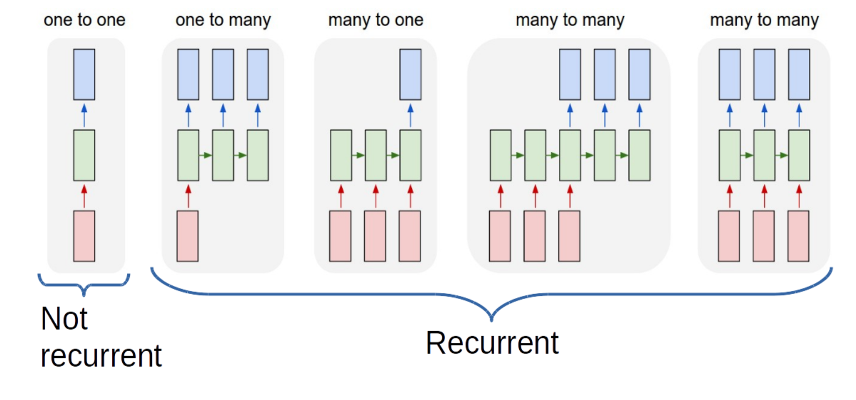
Recurrent Neural Networks
Applications:
Time-series forecasting
Audio processing
Translation
….
Do CNNs also apply ?
Notes:
feedforward network = feedforward neural network = multilayer perceptron

Slide 8
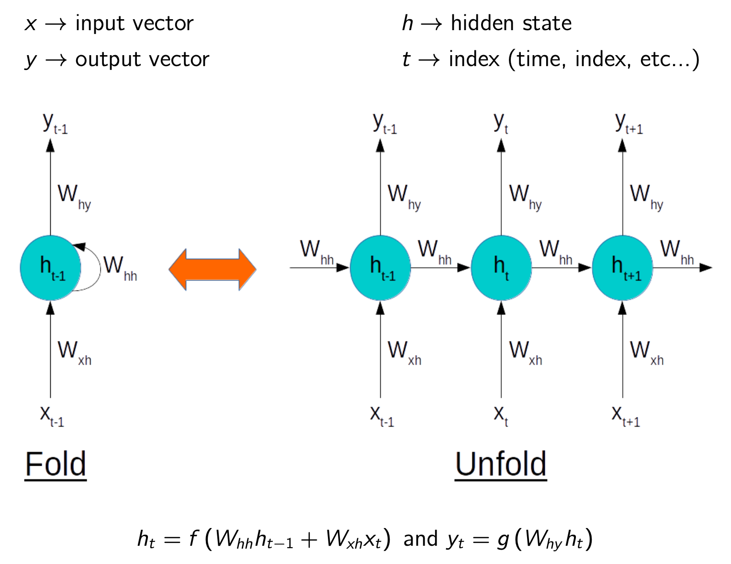
RNN: Underlying formulation (similar to state-space representation)
Notes:
feedforward network = feedforward neural network = multilayer perceptron

Slide 9
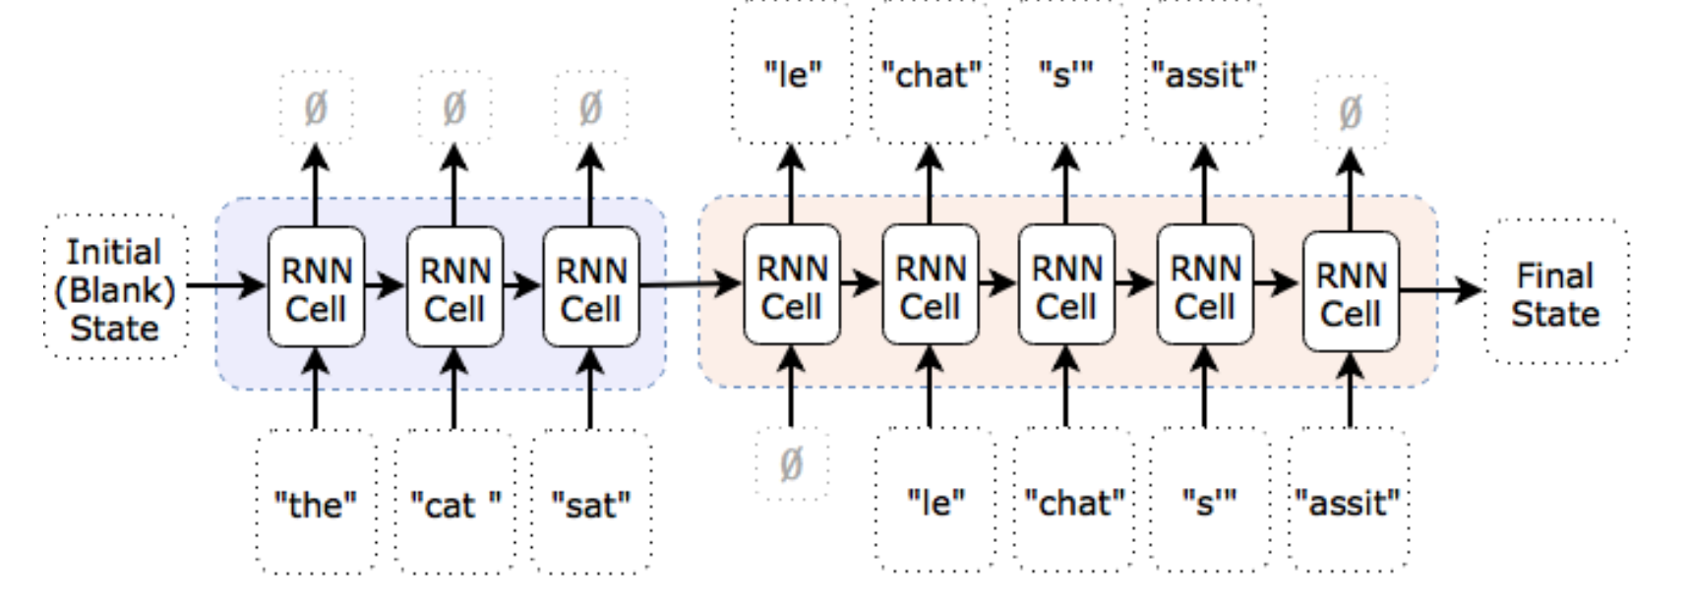
RNN: Underlying formulation (similar to state-space representation)
Notes:
feedforward network = feedforward neural network = multilayer perceptron

Slide 10
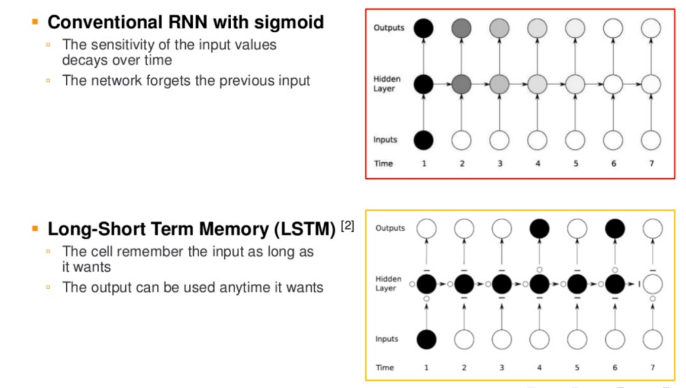
Classic RNN Architectures
Dense and convolutional versions of LSTM and GRU exist
(depending on the structure of the hidden state)
Notes:
feedforward network = feedforward neural network = multilayer perceptron

Slide 11
Short-term forecasting application (L63 case-study)
https://github.com/CIA-Oceanix/DLOA2023/blob/main/lectures/notebooks/notebook_PytorchLightning_Forecasting_L63_students.ipynb
Notes:
feedforward network = feedforward neural network = multilayer perceptron

Slide 12
Lecture. #3
Things to know (RNN)
Recurrent Neural Network
LSTM
Unfloded and folded representations
Notes:
feedforward network = feedforward neural network = multilayer perceptron

Slide 13
Physics-informed/theory-guided networks
Notes:
feedforward network = feedforward neural network = multilayer perceptron

Slide 14
General question
How to exploit physical knowledge in the design of neural networks ?
Notes:
feedforward network = feedforward neural network = multilayer perceptron

Slide 15
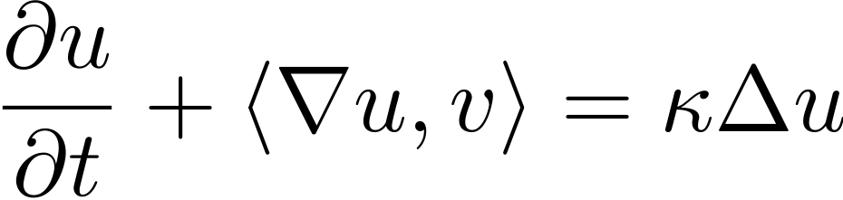
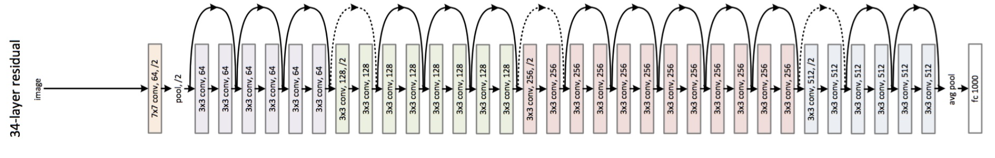
Bridging physics & AI: a broader picture
Representation learning
Trainable representation
Physical model
Making the most of AI and Physics Theory
Model-Driven/Theory-Guided & Data-Constrained schemes
Data-Driven & Physics-Aware schemes (eg, Ouala et al., 2019)

Slide 16
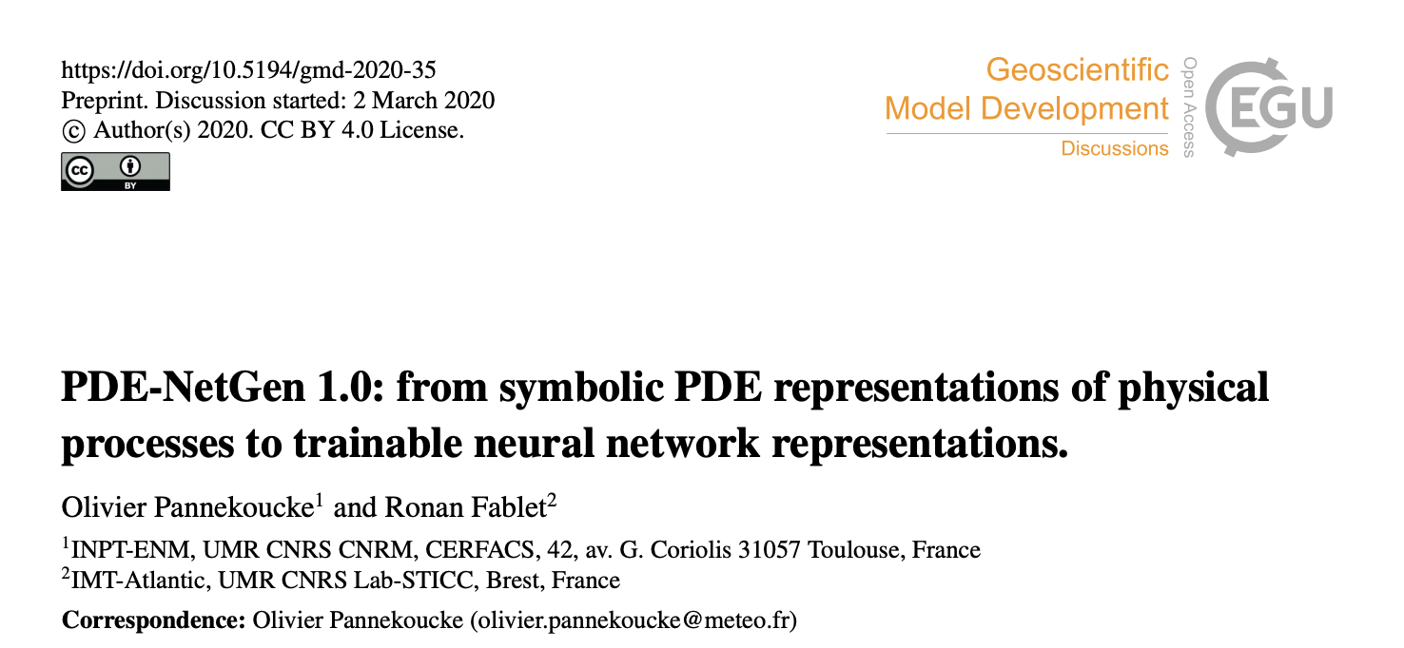
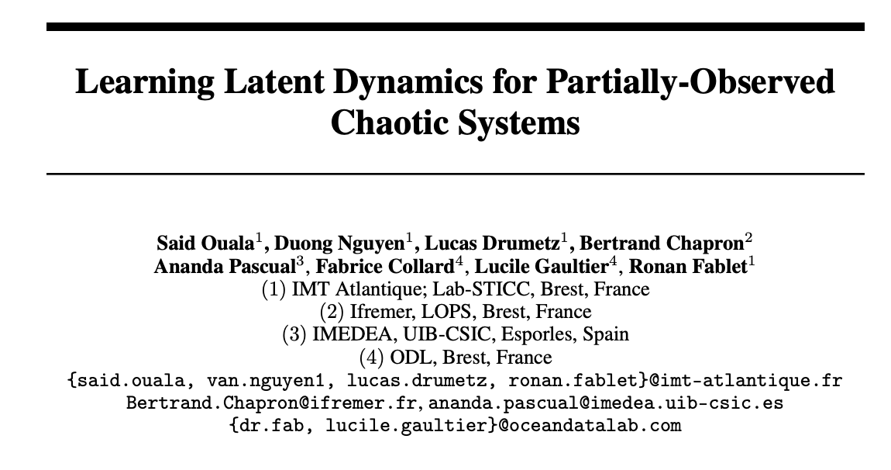
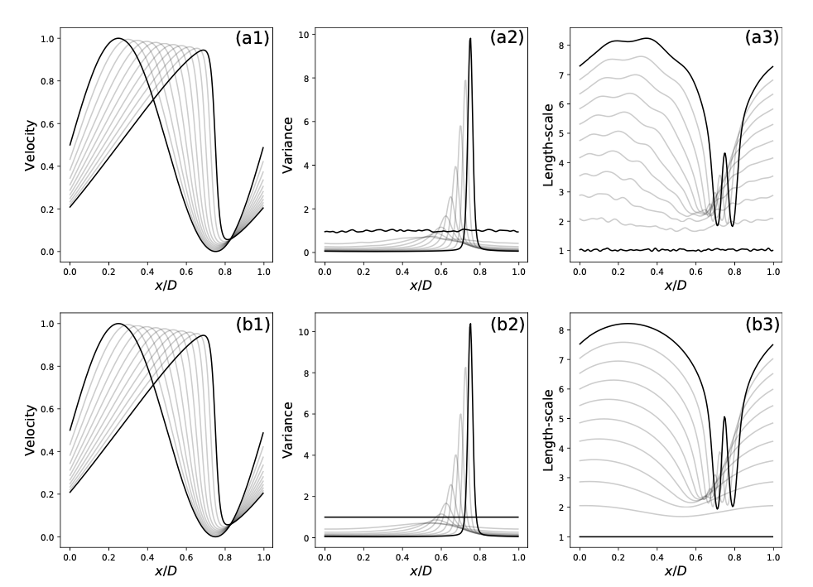
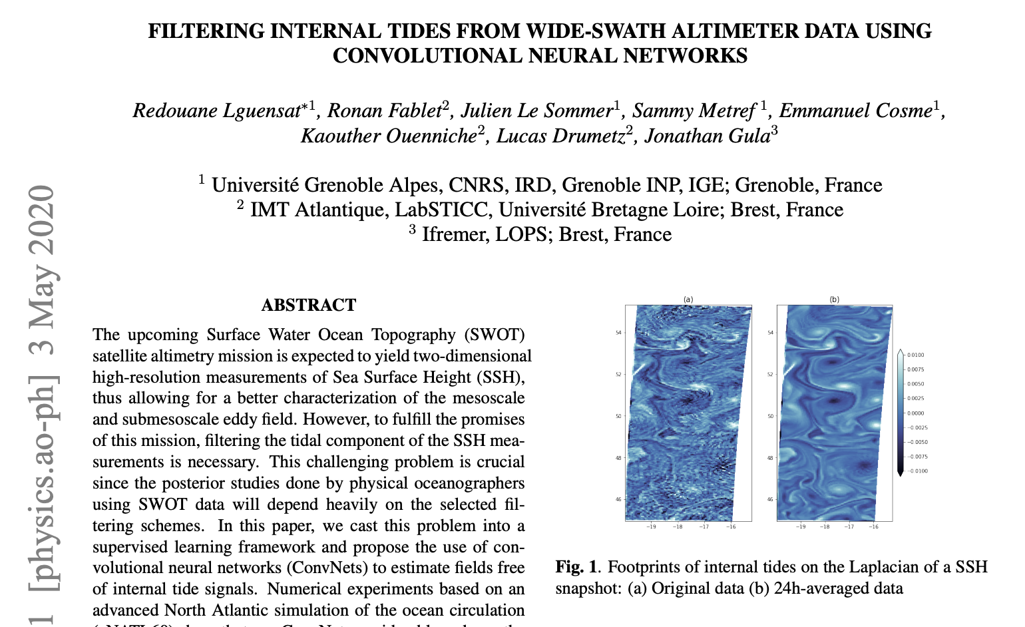
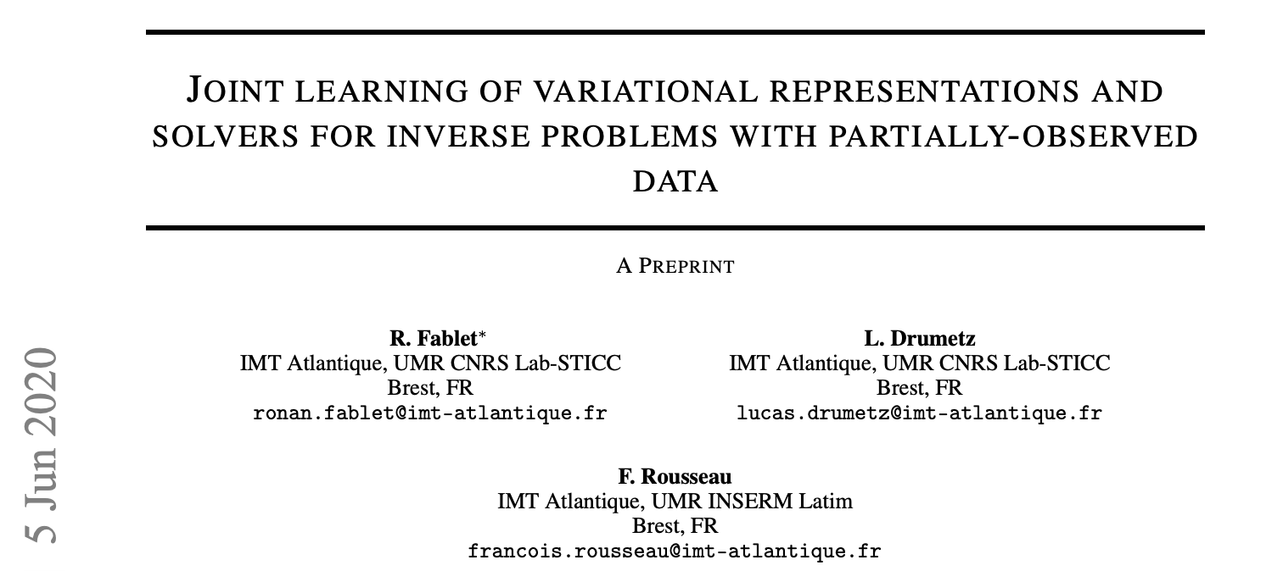
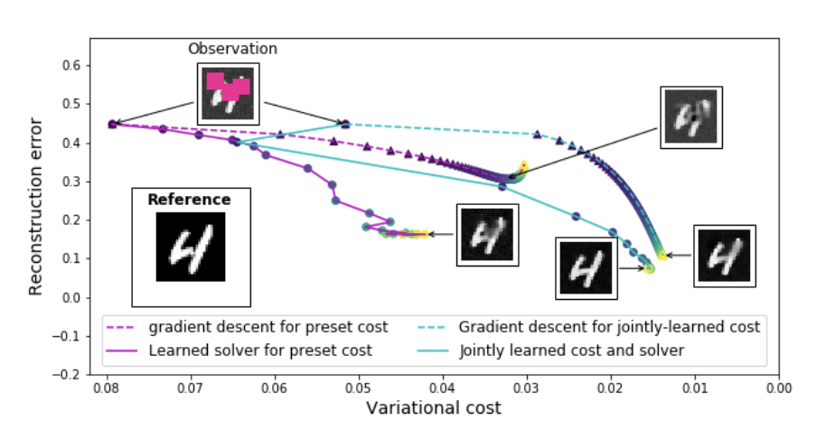
Bridging Physics & AI: a broader picture
Model-driven
Data-driven
ODEs/PDEs
Variational models
State-space models
Data Assimilation
….
Analog methods
Kernel methods
Neural Networks
…..
Link to animation
Physics-informed &
Data-constrained
Data-driven &
Physics-aware

Slide 17
Bridging physics & AI: a broader picture
Representation learning
Trainable representation
Physical model
Making the most of AI and Physics Theory
Model-Driven/Theory-Guided & Data-Constrained schemes
Data-Driven & Physics-Aware schemes (eg, Ouala et al., 2019)

Slide 18
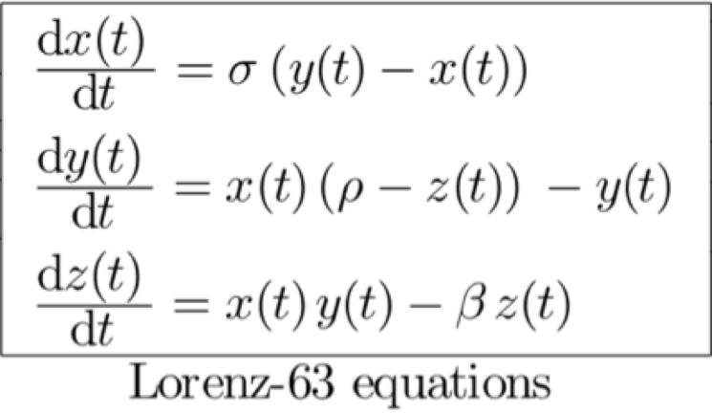
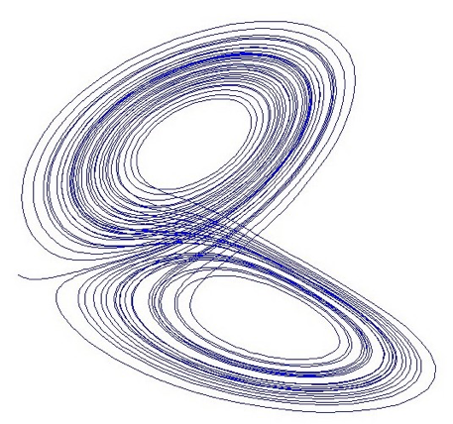
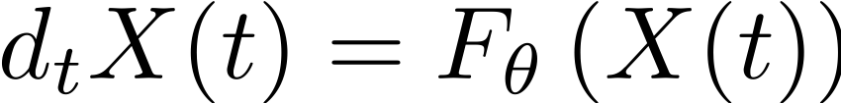
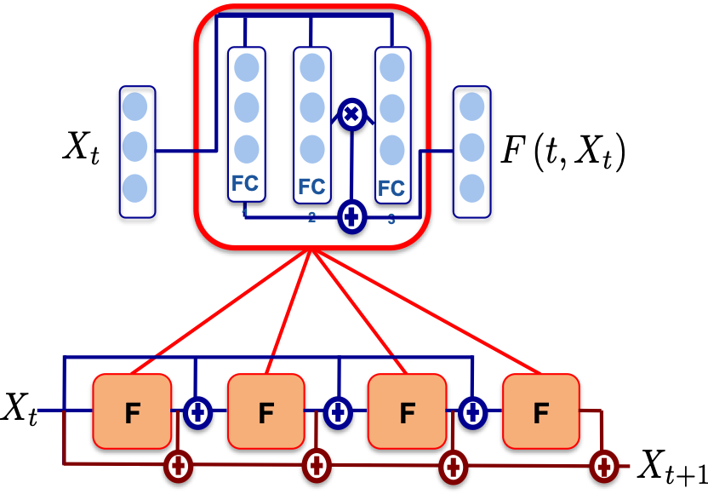
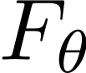
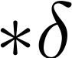
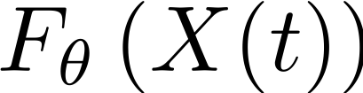
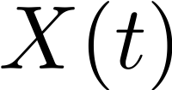
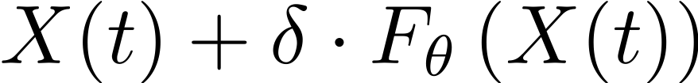
How to embed physics-driven priors in DL models ?
An illustration through L63 dynamics: numerical experiments (Fablet et al., 2018)
Associated Euler integration scheme
NN architecture for differential operator
NN architecture for integration scheme
+
Bilinear architecture
ResNet architecture (Residual Network)

Slide 19
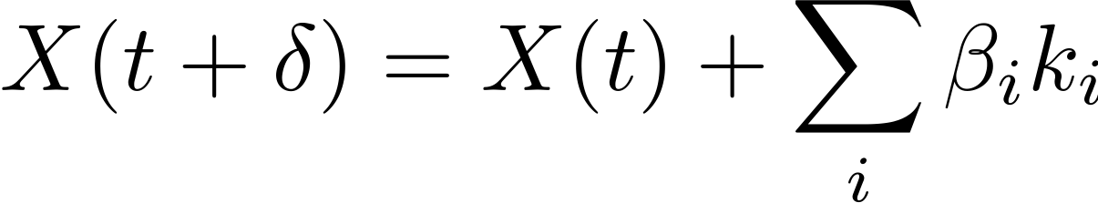
How to embed physics-driven priors in DL models ?
An illustration through L63 dynamics: numerical experiments (Fablet et al., 2018)
Generalization to higher-order integration schemes (eg, RK4)
NB: Same number of trainable model parameters as the Euler-based architecture
with

Slide 20
How to embed physics-driven priors in DL models ?
Implementation for L63 dynamics
https://github.com/CIA-Oceanix/DLOA2023/blob/main/lectures/notebooks/notebook_PytorchLightning_Forecasting_L63_students.ipynb

Slide 21

How to embed physics-driven priors in DL models ?
An illustration through L63 dynamics: numerical experiments (Fablet et al., 2018)
Forecasting experiments
Noise-free training data
Forecasting time step | t₀+h | t₀+4h | t₀+8h
Analog forecasting | <10⁻⁶ | 0.002 | 0.005
Sparse regression | <10⁻⁶ | 0.002 | 0.006
MLP | <10⁻⁶ | 0.018 | 0.044
Bi-NN(4) | <10⁻⁶ | <10⁻⁶ | <10⁻⁶
Assimilation experiment
(1 obs. every 8 time steps)
Noise standard deviation in training data | 0 | 0.25 | 1
True model | 0.50 | - | -
Analog forecasting | 0.65 | 1.17 | 1.81
Bi-NN(4) | 0.60 | 0.75 | 0.86
Noisy training data (σ=0.5)
Forecasting time step | t₀+h | t₀+4h | t₀+8h
Analog forecasting | <10⁻⁶ | 2.01 | 2.2
Bi-NN(4) | <10⁻⁶ | 0.054 | 0.14
Notes:
Point here different variables for the search for analogs, similarity weights and/or regression variables

Slide 22


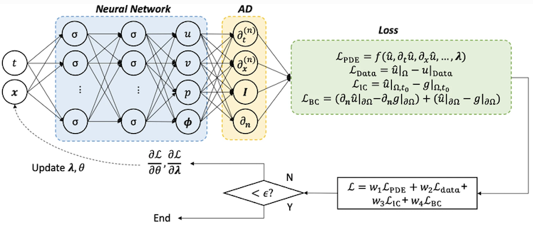
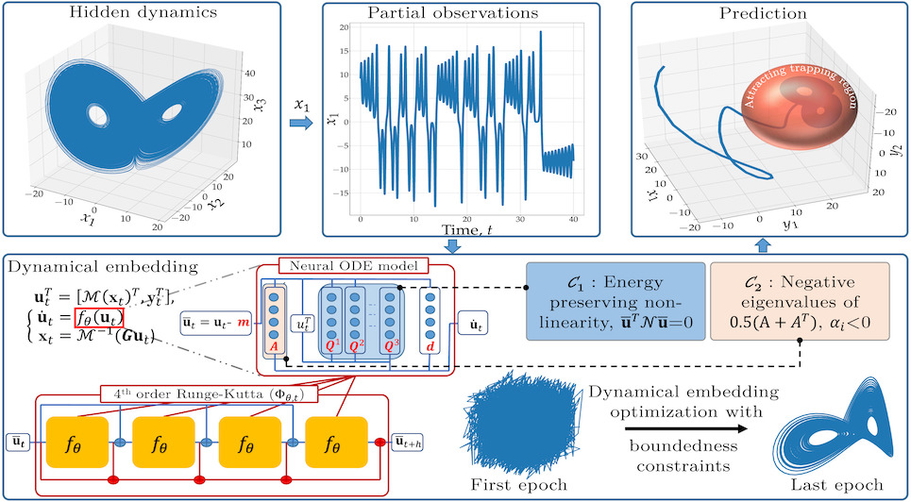


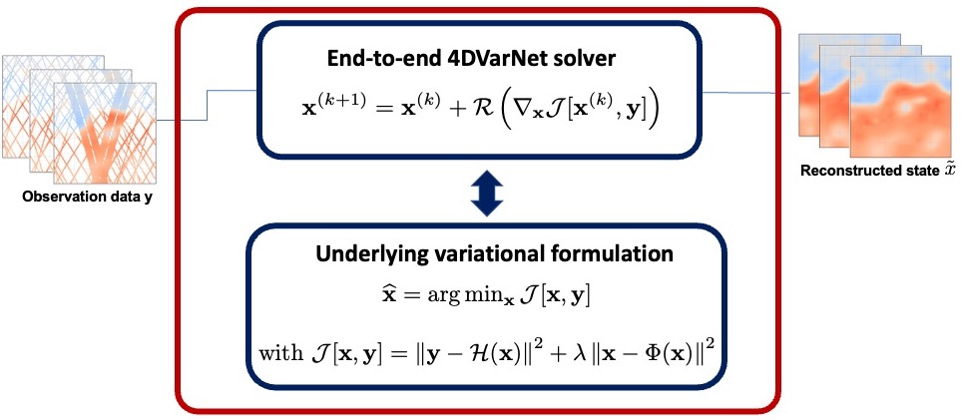

Physics-informed neural architectures
PINNS for ODEs/PDEs (from Cai et al., 2021)
Identification of ODEs (Ouala et al., 2021)
Other physics-informed representation: Hamiltonian representations [eg, Greydanus et al., 2019], Fourier representations [eg, Li et al., 2021]
Variational data assimilation (Fablet e tal., 2021)
From a Variational DA formulation
Associated end-to-end scheme
Trainable variational model
Trainable gradient-based solver

